Slide 1
Demo of Spring Core & Spring MVC with REST API
By Yogita Balpande

Slide 2
Problem Statement
The first application will handle customer details and its multiple identity documents with details like document id , address issue, expiary date etc…
The Spring MVC/Spring Boot application will provide Rest API for creation, inquiry and update the details.

Slide 3
Solution
Developed solution to cater problem need using below technology/Tool
SPRING MVC / SPRING REST
Core JAVA
Logger (log4J)
REST API
Tomcat Sever
POSTMAN
Apache Maven

Slide 4
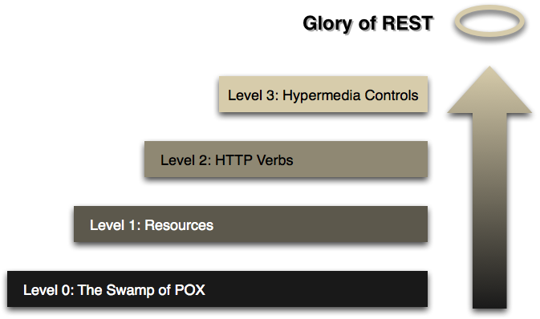
Richardson Maturity Model

Slide 5
REST API
GET Method
http://localhost:8080/SpringRestfulWebServicesExample/customers/
GET Method
http://localhost:8080/SpringRestfulWebServicesExample/customers/{customerId}
POST Method
http://localhost:8080/SpringRestfulWebServicesExample/customers/
PUT Method
http://localhost:8080/SpringRestfulWebServicesExample/customers/
DELETE Method
http://localhost:8080/SpringRestfulWebServicesExample/customers/{customerId}
GET Method
http://localhost:8080/SpringRestfulWebServicesExample/customers/gender/{gender}
GET Method
http://localhost:8080/SpringRestfulWebServicesExample/customers/dob/(dateOfBirth}
GET Method
http://localhost:8080/SpringRestfulWebServicesExample/customers/{gender}/{dateOfBirth}

Slide 6
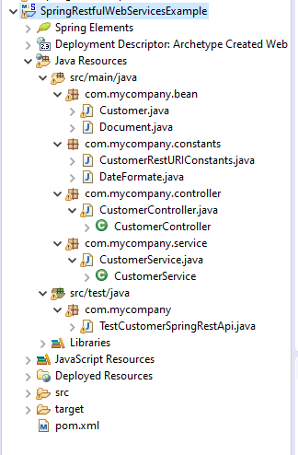
Project Structure

Slide 7
DEMO
Demo all API using postman
Source code
https://github.com/Ybalpand/SpringMvcUsingRMM
Suggestions and Feedback
list down all suggestion for improvement and enhancement.

Slide 8
Thanks you

Slide 9
2nd Problem statement Q
I Want Some Clarity on next task
Can I extend same application for db connectivity
And used java 8 features .
What do u mean by collating filter data using java 8.

